Slide 1
ISWE Mentorship Programme
2025
Mentor Training
ISWE are grateful to the Central Bank of Ireland for providing support and mentorship materials to the ISWE Mentorship Programme
13th February 2026

Slide 2

Welcome

Slide 3
Objectives
Understand the mentoring programme and process
Identify the role and responsibilities of a mentee and mentor
Prepare for your first meeting to ensure you get off to a positive start
Become familiar with the tools and resources available to you
Understand next steps and have any questions answered

Slide 4

Agenda
What is Mentoring?
Roles & Responsibilities
Skills and Characteristics of an Effective Mentor
Preparing for the First Meeting
Overview of Tools & Resources Available
Q&A

Slide 5
Programme Timeline
Applications Open
Official mentoring relationships begin
Mid-February Training sessions for mentors and mentees
November
December
February
March
May
June
October
Matches finalised and communicated to participants
Unsuccessful applicants contacted
Participants invited to a mid-point event: training and networking
End of nine month mentoring relationships
Participants asked to share their feedback of the programme

Slide 6

How were the matches decided upon?
Criteria for a successful match:
Mentor to be at least 1 grade/level above mentee
Mentors and mentees not from the same institution
At least 3 common tick boxes ‘Which of the following are you available to offer experience on?/ ‘Experience in which of the following would be important in your mentor? ’
Objectives review:
‘What are you hoping to get out of the ISWE mentorship programme?’

Slide 7


Have you any previous experience of mentoring?

Slide 8

Experience
Have you any experience of mentoring?
Who has been a Mentee or Mentor before?

Slide 9
What is Mentoring?

Slide 10
What is Mentoring?
“We’re here for a reason. I believe a bit of the reason is to throw little torches out to lead people through the dark.” — Whoopi Goldberg
Mentoring takes a long term, broader perspective than coaching, helping the learner develop a clearer sense of career direction and broader, more intuitive skills
The mentor acts as sounding board, counsellor and advisor as well as helping the learner build more effective networks –Chartered Institute of Personnel and Development

Slide 11
What is Traditional Mentoring?
Mentoring is a form of professional and personal development:
that recognises we all learn from the experience, skills and wisdom of others
where the relationship based upon mutual trust and respect
where the mentor acts as a facilitator to the mentee’s learning and growth
where the mentee is responsible for their own learning and growth

Slide 12
What is Mentoring?
What Mentoring Is ✔
What Mentoring Is Not 🗶

Slide 13
What is Mentoring?
What Mentoring Is ✔
What Mentoring Is Not 🗶
Opportunity to enhance an individual’s skills, knowledge and work performance
Access to independent and objective perspectives
Sounding board, someone who has ‘been there, done that’
Space to learn in a confidential and safe environment
Helping a mentee with honest evaluations
Enables mentees to make decisions by looking at consequences, impacts and alternatives
Opportunity to enhance professional network
Learning opportunity for both sides

Slide 14
What is Mentoring?
What Mentoring Is ✔
What Mentoring Is Not 🗶
Opportunity to enhance an individual’s skills, knowledge and work performance
Access to independent and objective perspectives
Sounding board, someone who has ‘been there, done that’
Space to learn in a confidential and safe environment
Helping a mentee with honest evaluations
Enables mentees to make decisions by looking at consequences, impacts and alternatives
Opportunity to enhance professional network
Learning opportunity for both sides
Providing opportunities for unchallenged ventilation about relationship issues
Dealing with an individual’s underperformance
Being judgemental
Making promises in relation to career development or any issues discussed
Line manager replacement
Supervisor replacement
Co-author replacement

Slide 15

Mentoring vs. Coaching?

Slide 16


Mentoring vs. Coaching?
Coaching is performance-driven, designed to improve on-the-job performance
Mentoring on the other hand is more development-driven, looking not just at the mentee’s current position but beyond, taking a more holistic approach to personal development
Coach | Mentor
A coach is someone who can develop your skills and train you on specific areas | A mentor is someone who offers their knowledge, expertise, advice and guidance to those with less experience
Short term | Longer term
More structured | More informal
Coach is more likely to drive the session | Mentee more likely to drive the session
Not required to share past experience | More likely to share their personal experience with mentees

Slide 17
Roles & Responsibilities

Slide 18






Mentor Requirements
Mentors are required to;
Commit to meeting your mentee for at least one hour every six weeks for the duration of the programme
Be a sounding board to your mentee providing them with advice and guidance in relation to their career development
Share your knowledge and experience with your mentee to help them find solutions to issues they are facing
Treat all mentoring discussions as confidential, build a trusting and supportive relationship
Provide the ISWE team with feedback through online surveys when requested

Slide 19


Mentee Requirements
Mentees are required to;
Commit to and arrange meeting your mentor for at least one hour every six weeks for the duration of the programme
Attend the mentee training session before your first meeting
Be proactive in your mentoring relationship taking the lead in arranging meetings, driving topics for discussion and arriving fully prepared
Be open and honest with your mentor about your challenges, situation and goals
Provide the ISWE team with feedback through online surveys when requested

Slide 20


Skills and Characteristics
What makes a great mentor?
What do you believe are some of the key skills and characteristics of a great mentor?
Discussion
5 minutes

Slide 21

Skills and Characteristics
Mentor Skills
Desire to help others develop
Listening
Questioning: to stimulate new thinking
Be non-judgmental
Ability to reflect & paraphrase
Comfortable giving honest, constructive feedback
Ability to build rapport & create a trusting environment
What makes a great mentor?

Slide 22
Skills and Characteristics
What makes a great mentor?
Mentor Characteristics
Comfortable with own status, accomplishments & sharing relevant professional experience
Ability to determine how mentee learns best and emphasise their strengths
Access own perspective, experience, and ‘teachable points of view’
Willing to listen, challenge, and support as appropriate
Openness, Honesty, and Trust – the best Mentoring relationships come where the Mentee feels that they can engage fully, irrespective of ‘level’ or ‘status’

Slide 23
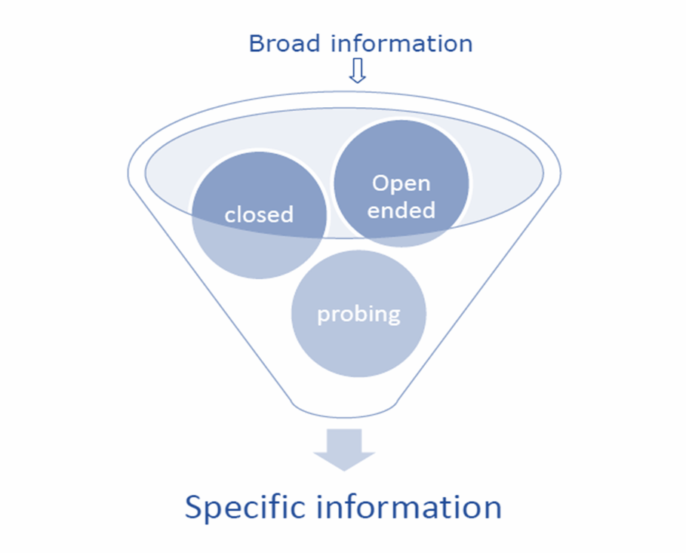
Skills and Characteristics
Asking the right questions and listening to the responses helps your mentee to feel comfortable with both the process and the outcome of the conversation with you.
The key types of questions for you as mentor are:
Open ended questions
Probing questions
Closed questions (sometimes)
Reflective questions

Slide 24
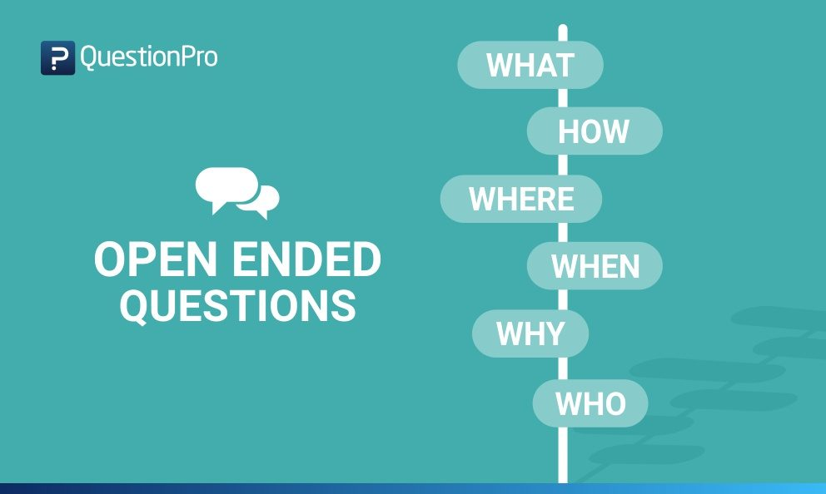
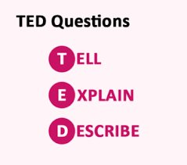
Skills and Characteristics
Open question techniques

Slide 25
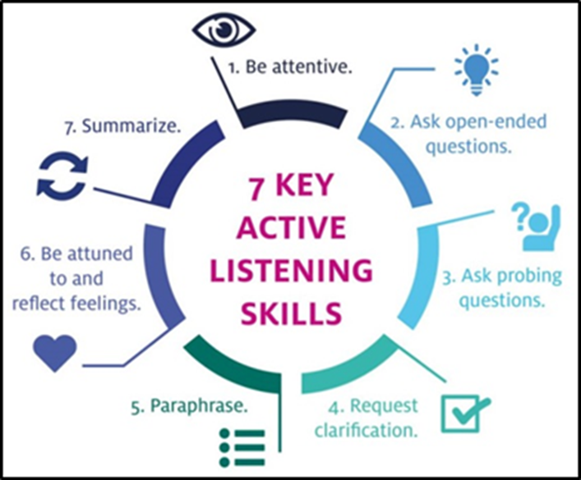

Skills and Characteristics
Active Listening
One of the most important skills for a mentor is the ability to really listen to what your mentee is saying & to ask questions which help the mentee to come to the right conclusions.

Slide 26
First Meeting

Slide 27
First Meeting
What should be discussed in the first meeting with your mentee?
Discussion
5 minutes

Slide 28
First Meeting
Introduction
You
Your role
Your background
Why you applied- what do you want to gain as a mentor?
What do they want to gain as a mentee?

Slide 29
First Meeting
Introduction
Expectations
You
Your role
Your background
Why you applied- what do you want to gain as a mentor?
What do they want to gain as a mentee?
Logistics
Communication
Structure
Boundaries
Confidentiality

Slide 30
First Meeting
Introduction
Expectations
Define
Success
You
Your role
Your background
Why you applied- what do you want to gain as a mentor?
What do they want to gain as a mentee?
Logistics
Communication
Structure
Boundaries
Confidentiality
Preparation?
Objectives
Measure
Review Success

Slide 31
First Meeting
Introduction
Expectations
Define Success
Next Meeting
You
Your role
Your background
Why you applied- what do you want to gain as a mentor?
What do they want to gain as a mentee?
Logistics
Communication
Structure
Boundaries
Confidentiality
Objectives
Measure
Review Success
Agree date
Agree topic

Slide 32
First Meeting
Who has taken part in a Mentoring Programme before?
What worked well in the first meeting?

Slide 33
First Meeting: Support Materials
First Meeting: Support Materials
At the start of a mentoring partnership, it is essential to discuss mutual expectations and establish a set of ground rules as to how the relationship will be conducted
This will ensure that the relationship develops effectively and that mentee needs are met
Use this first meeting template to ensure that you have agreed on the most important aspects of the Mentoring Partnership
Checklist can be found on the Mentoring tile on the ISWE website

Slide 34

Goal Setting- common focus areas provided to mentees
Some common mentee focus areas can include but are not limited to:
Career planning/ trajectories e.g. next steps/5-year plans
Confidence skills
Gain visibility for potential promotions
Learn the workplace culture
Life/work balance
Networking
Skills development (Problem-solving skills, Leadership skills, Public speaking/presentation skills)

Slide 35
Goal Setting- Prepare for Mentoring Checklist Provided to Mentees
The following questions will help you get the most out of being mentored, not all questions will be useful, simply answer those which feel most relevant or helpful.
What is my purpose for being mentored, why am I doing this?
What do I need to know about my Mentor?
Which specific Personal Development Objectives do I want to focus on?
What are my potential barriers to getting the most out of this opportunity and how will I overcome them?
What requests or agreements might I want to make of my mentor, e.g. their level of challenge, type of support I need, etc.?

Slide 36

Mentee Info: Subsequent meetings
Remember your Goals for the Programme
Learn about your mentor’s personal career journey and discuss your career aspirations
Explore your own personal development objectives & those of your mentor
Use your Mentor as a confidential sounding board
What do you need to prepare before each meeting? Discuss this with your mentor
Does your mentor want to know the topic for discussion beforehand? Agree this with them
Complete your Mentee Learning Log

Slide 37

Subsequent meetings: Mentee Support Materials
We have provided all mentees with a Mentee Learning Log
This document is used to:
Record their objectives for each mentoring session. Before your first mentoring session, the mentee should complete this section themselves. They may what to inform you of the meeting objectives before you meet
Record the key discussion points of the mentoring session. The mentee should complete this section as soon as possible after each meeting to record what you discussed
Action points agreed: your mentee should complete this section with you during each meeting to record any actions you have agreed to take

Slide 38
Additional Tools & Resources
1. Mentoring programme guidelines
2. Mentor factsheet
3. Mentee​ factsheet
4. ISWE Mentoring Information Pack
5. First meeting template
6. Mentee Checklist & Learning Log-
Additional guidance on wrapping up the partnership will also be shared.

Slide 39
Questions?
ISWE Mentoring Programme

Slide 40

Be proactive
Be Prepared
Be open
Be realistic
ISWE Mentoring Programme

Slide 41
Thank You
Acknowledgements:
ISWE are grateful to the Central Bank of Ireland for providing support and mentorship materials to the ISWE Mentorship Programme

