Slide 1
ISWE MENTORSHIP PROGRAMME 2026
Mentee Training
13th February 2026

Slide 2

Welcome

Slide 3

Agenda
Objectives and what to expect today
Who are ISWE?
What is Mentoring?
Roles & Responsibilities
Skills and Characteristics of an Effective Mentee!
Goal Setting for the Mentoring Partnership
Prepare for the First Meeting
Overview of Tool & Resources Available
Q&A

Slide 4
Objectives & Context

Slide 5
Objectives
Understand the mentoring programme and process you have signed up for.
Identify the role and responsibilities of a mentee and mentor.
Prepare for your first meeting and ensure you get off to a positive start.
Become familiar with the tools and resources available to you.
Understand next steps and have questions answered.

Slide 6
Programme Timeline
Mid February Training sessions for mentors and mentees.
Resources available on the ISWE website
Applications Open for All Streams
Official mentoring relationships begin
November
December
February
March
June
July
November
Matches finalised and communicated to participants
Unsuccessful applicants contacted
Participants asked to share their feedback on the programme at the halfway point
End of nine month mentoring relationships
Participants asked to share their feedback of the programme

Slide 7
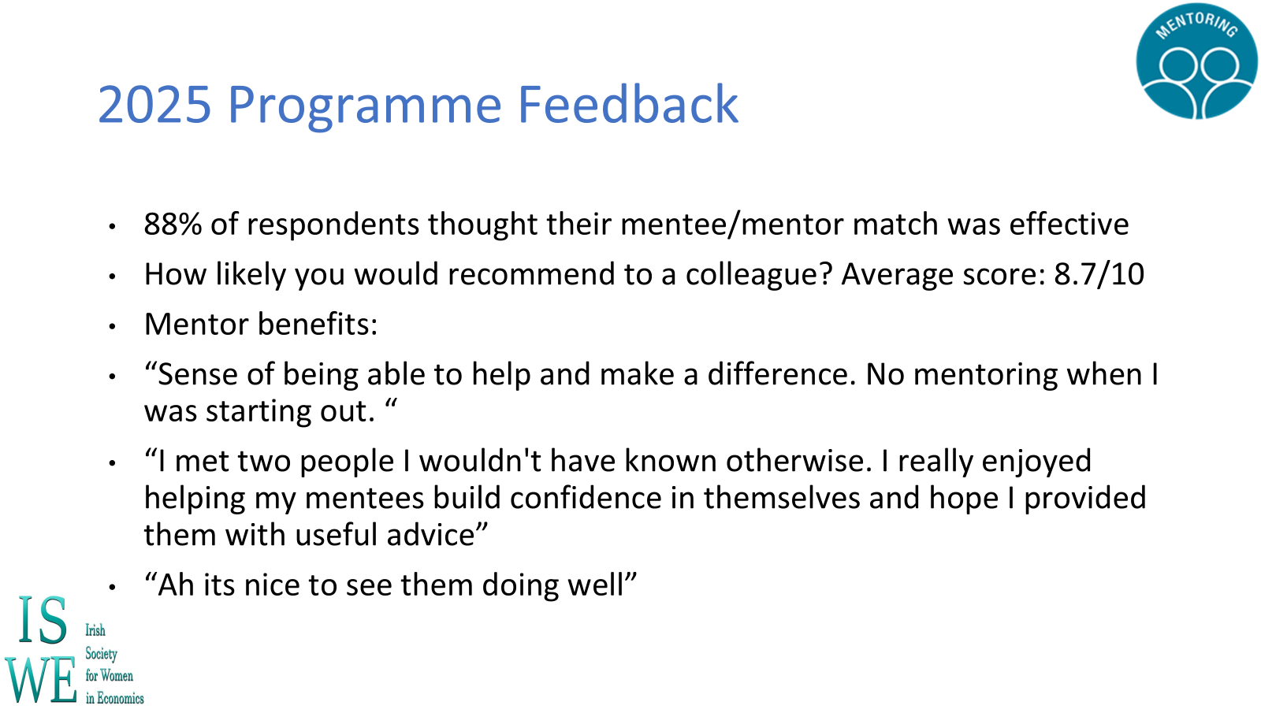
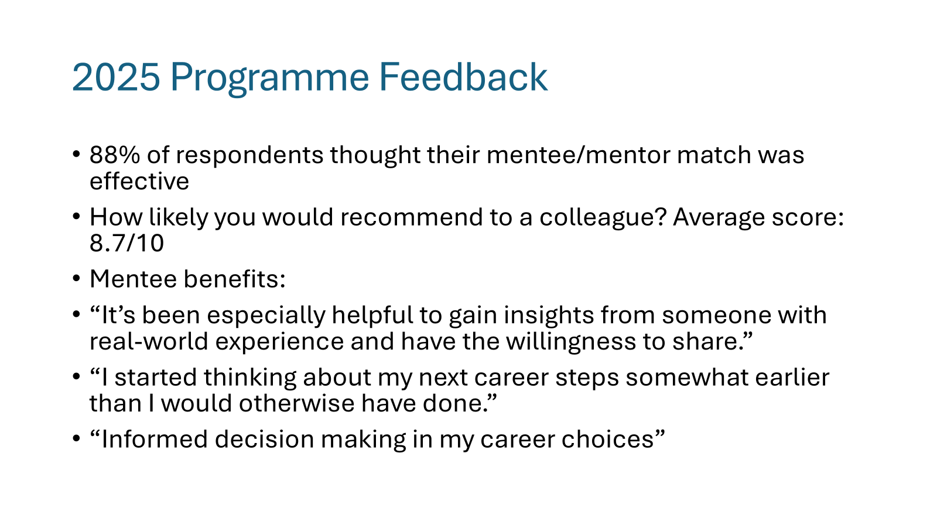

Slide 8


Have you any previous experience of mentoring?

Slide 9
What is Mentoring?

Slide 10
What is Mentoring?
Mentoring takes a long term, broader perspective than coaching, helping the learner develop a clearer sense of career direction and broader, more intuitive skills.
The mentor acts as a sounding board, counsellor and advisor as well as helping the learner build more effective networks – Chartered Institute of Personnel and Development
“Mentoring is a brain to pick, an ear to listen and a push in the right direction”
John C. Crosby, - U.S Congressman & Supreme Court Judge

Slide 11
What is Mentoring?
Mentoring, be it Traditional or Group Mentoring, is a form of professional and personal development:
which recognises that we all learn from the experience, skills and wisdom of others
where the relationship is based upon mutual trust and respect
where the mentor acts as a facilitator to the mentee’s learning and growth
where the mentee is responsible for their own learning and growth

Slide 12
What is Mentoring?
What Mentoring Is ✔
What Mentoring Is Not 🗶

Slide 13
What is Mentoring?
What Mentoring Is ✔
What Mentoring Is Not 🗶
Opportunity to enhance an individual’s skills, knowledge and work performance
Access to independent and objective perspectives
Sounding board, someone who has ‘been there, done that’
Space to learn in a confidential and safe environment
Helping a mentee with honest evaluations
Enables mentees to make decisions by looking at consequences, impacts and alternatives
Opportunity to enhance professional network
Learning opportunity for both sides

Slide 14
What is Mentoring?
What Mentoring Is ✔
What Mentoring Is Not 🗶
Opportunity to enhance an individual’s skills, knowledge and work performance
Access to independent and objective perspectives
Sounding board, someone who has ‘been there, done that’
Space to learn in a confidential and safe environment
Helping a mentee with honest evaluations
Enables mentees to make decisions by looking at consequences, impacts and alternatives
Opportunity to enhance professional network
Learning opportunity for both sides
Providing opportunities for unchallenged ventilation about relationship issues
Dealing with an individual’s underperformance
Being judgemental
Making promises in relation to career development or any issues discussed
Line manager/ PhD supervisor replacement
An opportunity for specific detailed feedback on pieces of work or peer review

Slide 15
What is Group Mentoring?
Up to three mentees with similar objectives assigned to one mentor
Meet and work as a group, sharing their collective range of perspectives, connections and experiences
Flexible take on traditional mentoring, all the existing plus some added benefits:
  Mentees may feel more comfortable in a group setting
  Mentees benefit from multiple/peer perspectives
  Network building is accelerated
  Mentor communication and influencing skills can be developed in a group setting
  Increases the number of mentees that a single mentor can mentor

Slide 16

Mentoring vs. Coaching?

Slide 17


Mentoring vs. Coaching?
Coaching is performance-driven, designed to improve a person’s on-the-job performance.
Mentoring on the other hand is more development-driven, looking not just at the person’s current position but beyond, taking a more holistic approach to personal development.
Coach | Mentor
A coach is someone who can develop your skills and train you on specific areas | A mentor is someone who offers their knowledge, expertise, advice and guidance to those with less experience
Short term | Longer term
More structured | More informal
Coach is more likely to drive the session | Mentee more likely to drive the session
Not required to share past experience | More likely to share their personal experience with mentees

Slide 18
Roles & Responsibilities

Slide 19





Mentee Requirements
Mentees are required to;
Commit to meeting your mentor for at least one hour every six weeks for the duration of the programme
Attend the mentee training session and review all materials before your first meeting.
Be proactive in your mentoring and drive the relationship by 1) scheduling/arranging meetings; 2) driving topics for discussion and; 3) arriving fully prepared
Be open and honest with your mentor about your challenges, situation and goals
Provide the ISWE Mentorship team with feedback through online surveys when requested

Slide 20



Mentor Requirements
Mentors are required to;
Commit to meeting your mentee for at least one hour every six weeks for the duration of the programme
Attend the mentor training session (if you haven’t already) and review the updated materials
Be a sounding board to your mentee providing them with advice and guidance in relation to their career development
Share your knowledge and experience with your mentee to help them find solutions to issues they are facing
Treat all mentoring discussions as confidential, ensuring to build a trusting and supportive relationship
Provide the ISWE mentorship team with feedback through online surveys when requested

Slide 21


Skills and Characteristics
Breakout discussion
What do you believe are some of the key skills and characteristics of an effective Mentee?
10 minutes

Slide 22

Skills and Characteristics
What makes a great mentee?
Clear on what their goals are
Keeps an open mind
Desires to be developed
Commits the time
Is open to feedback
Asks open & probing questions
Follows up and stays connected
Actively listens
Desires professional accomplishment
Curious
Enthusiastic
Prepared
Proactive

Slide 23
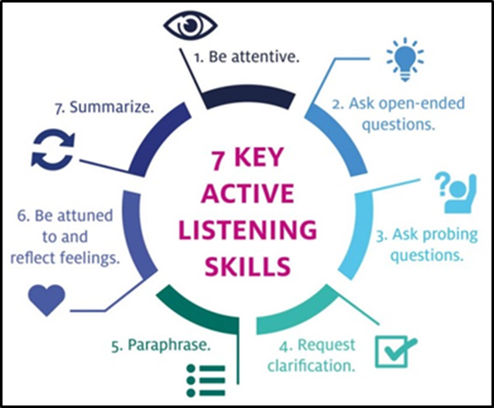
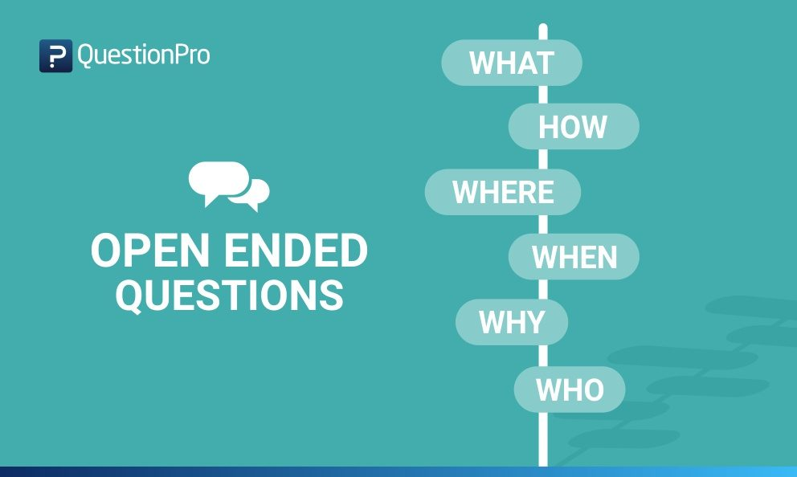
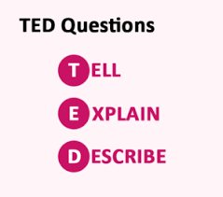
Skills and Characteristics
What makes a great mentee?

Slide 24

Goal Setting

Slide 25
Goal Setting
Prepare for Mentoring Checklist
The following questions will help you get the most out of being mentored, not all questions will be useful, simply answer those which feel most relevant or helpful.
What is my purpose for being mentored, why am I doing this?
What do I need to know about my Mentor?
Which specific Personal Development Objectives do I want to focus on?
What are my potential barriers to getting the most out of this opportunity and how will I overcome them?
What requests or agreements might I want to make of my mentor, e.g. their level of challenge, type of support I need, etc.?
Some common mentee focus areas can include but are not limited to:
Career planning
Career trajectories/next steps/5-year plans
Confidence skills
Gain visibility for potential promotions
Leadership skills
Life/work balance
Networking
Problem-solving skills
Team-building skills
Public speaking/presentation skills
Skill development

Slide 26
Goal Setting
Consider what your ticked on your application form. We have tried our best to match you with a mentor with experience in the areas you wanted to learn more about.

Slide 27
Goal Setting
Traditional Mentoring
For mentee applications, experience in which of the following would be important in your mentor?
Length of time post PhD;
Experience with lateral moves, cross-divisional experience etc.;
Management experience;
Coaching;
Experience in policy/academic institutions
Interviewer experience;
Project management;
Work-life balance;
Personal development including further education and training;
Experience with Diversity & Inclusion initiatives
Influencing and Negotiation Skills
Group Mentoring
For Group Mentoring Partnerships we have matched you with Mentees on the same/a similar level to yourself who had similar objectives for the programme.
Mentees must meet in advance of first mentor meeting to discuss their goals and decide how meetings will be arranged!

Slide 28
Goal Setting
For mentee applications, experience in which of the following would be important in your mentor?
Length of time post PhD;
Experience with lateral moves, cross-divisional experience etc.;
Management experience;
Coaching;
Experience in policy/academic institutions
Interviewer experience;
Project management;
Work-life balance;
Personal development including further education and training;
Experience with Diversity & Inclusion initiatives
Influencing and Negotiation Skills

Slide 29
First Meeting

Slide 30
First Meeting
What should be discussed in the first meeting with your mentor?
Breakout session
10 minutes

Slide 31
First Meeting
Introduction
You
Your role
Your background
Why you applied

Slide 32
First Meeting
Introduction
Expectations
Logistics
Communication
Structure
Boundaries
Confidentiality
You
Your role
Your background
Why you applied

Slide 33
First Meeting
Introduction
Expectations
Define Success
Logistics
Communication
Structure
Boundaries
Confidentiality
Preparation?
Objectives
Measure
Review Success
You
Your role
Your background
Why you applied

Slide 34
First Meeting
Introduction
Expectations
Define Success
Next Meeting
You
Your role
Your background
Why you applied
Logistics
Communication
Structure
Boundaries
Confidentiality
Preparation?
Objectives
Measure
Review Success
Agree date
Agree topic

Slide 35
First Meeting
Who has taken part in a Mentoring Programme before?
What worked well in the first meeting?

Slide 36
First Meeting: Support Materials
At the start of a mentoring partnership, it is essential to discuss mutual expectations and establish a set of ground rules for the relationship
This will ensure the relationship develops effectively and that your needs are met
Use this first meeting to ensure that you have agreed on the most important aspects of the Mentoring Partnership
Checklist can be found on the Mentoring tile on the ISWE website
For Group Mentoring you will need to discuss a template as a group and reach a consensus

Slide 37
First Meeting: Support Materials
At the start of a mentoring partnership, it is essential to discuss mutual expectations and establish a set of ground rules for the relationship
This will ensure the relationship develops effectively and that your needs are met
Use this first meeting to ensure that you have agreed on the most important aspects of the Mentoring Partnership
Checklist can be found on the Mentoring tile on the ISWE website

Slide 38

Subsequent meetings
Remember your Goals for the Programme
Learn about your mentor’s personal career journey and discuss your career aspirations!
Explore your own personal development objectives & those of your mentor!
Use your Mentor as a confidential sounding board
What do you need to prepare before each meeting? Discuss this with your mentor
Does your mentor want to know the topic for discussion beforehand? Agree this with them
Complete your Mentee Learning Log

Slide 39

Subsequent meetings: Support Materials
We have provided all mentees with a Mentee Learning Log which should be used to:
Record your objectives for the mentoring session. Before your first mentoring session, you should complete this section yourself. You may what to inform your mentor of the meeting objectives before you meet. You and your mentor should then agree objectives for each upcoming session.
The key discussion points of your mentoring session: complete this section as soon as possible after each meeting to record what you discussed with your mentor during the session.
Action points agreed by you and your mentor: complete this section with your mentor during each meeting to record any actions you have agreed to take.

Slide 40
Additional Tools & Resources
1. Mentoring programme guidelines
2. Mentor factsheet
3. Mentee​ factsheet​
4. ISWE Mentoring Information Pack
​5. First meeting template
6. Mentee Checklist & Learning Log
Additional guidance on wrapping up the partnership will also be shared.

Slide 41
Questions?
ISWE Mentoring Programme

Slide 42

Be proactive
Be prepared
Be open
Be realistic
ISWE Mentoring Programme

Slide 43
Thank You
Acknowledgements:
ISWE are grateful to the Central Bank of Ireland for providing support and mentorship materials to the ISWE Mentorship Programme.

